Slide 1
UART Interface
Dr. Edward Nava
ejnava@unm.edu

Slide 2
PIC Architecture

Slide 3
UART Block Diagram

Slide 4
UART Interface
Characteristics
Asynchronous
Uses a minimum of two signal wires, Tx and Rx
Can use two optional flow control signals, Request to Send (RTS) and Clear to Send (CTS)
Full Duplex communication
Supports multiple protocols and configurations
Requires both Sender and Receiver configuration of data rates and protocol options.

Slide 5
Communication Between Devices
When devices are transferring data between each other, they require:
A protocol which defines how the data are to be extracted from the electrical signal.
A means by which to determine the start and the end of the transmission.

Slide 6
Asynchronous Communication Protocol Detail
For two UARTs to communicate with each other, both must be configured with identical values for:
Bit Rate Clock
Baud Rate
Framing
Start Bit
Data Bits
Parity (if used)
Stop Bits

Slide 7
UART Signals
For wired communications, the following signals are used:
Tx – Transmit Data
Rx – Receive Data
CTS – Clear to Send (Optional for hardware handshake)
RTS – Request to Sent (Optional for hardware handshake)
Note: The Tx line of one of the communicating devices must be tied to the Rx line of the other device and vice versa.

Slide 8
Signal Interconnects
UART 1
UART 2
TX
RX
RX
TX
RTS
CTS
CTS
RTS
Optional

Slide 9
UART Data Communication Protocol
When the communication link is idle, the transmit line is at a logical one level.
When a transmission is starting, the transmit line is lowered to a logical zero level and is held for one bit time. This is what is called the start bit.
Following the start bit, 8 or 9 data bits are transmitted.
If 8 data bits are being transmitted, an optional parity bit may be transmitted.
After the data and parity bits have been transmitted, the transmit line is raised to a logic one level for one or two bit times, indicating the end of the transmission. The end bit(s) are called the stop bit(s).

Slide 10
Single Character Transmission
The transmission begins with a start bit, which is followed by 8 or 9 data bits, then possibly a parity bit, and ends with one or more stop bits

Slide 11
Sequential Transmissions
With sequential transmissions, the start bit of the subsequent character(s) follows immediately after the prior transmission’s stop bit(s)

Slide 12
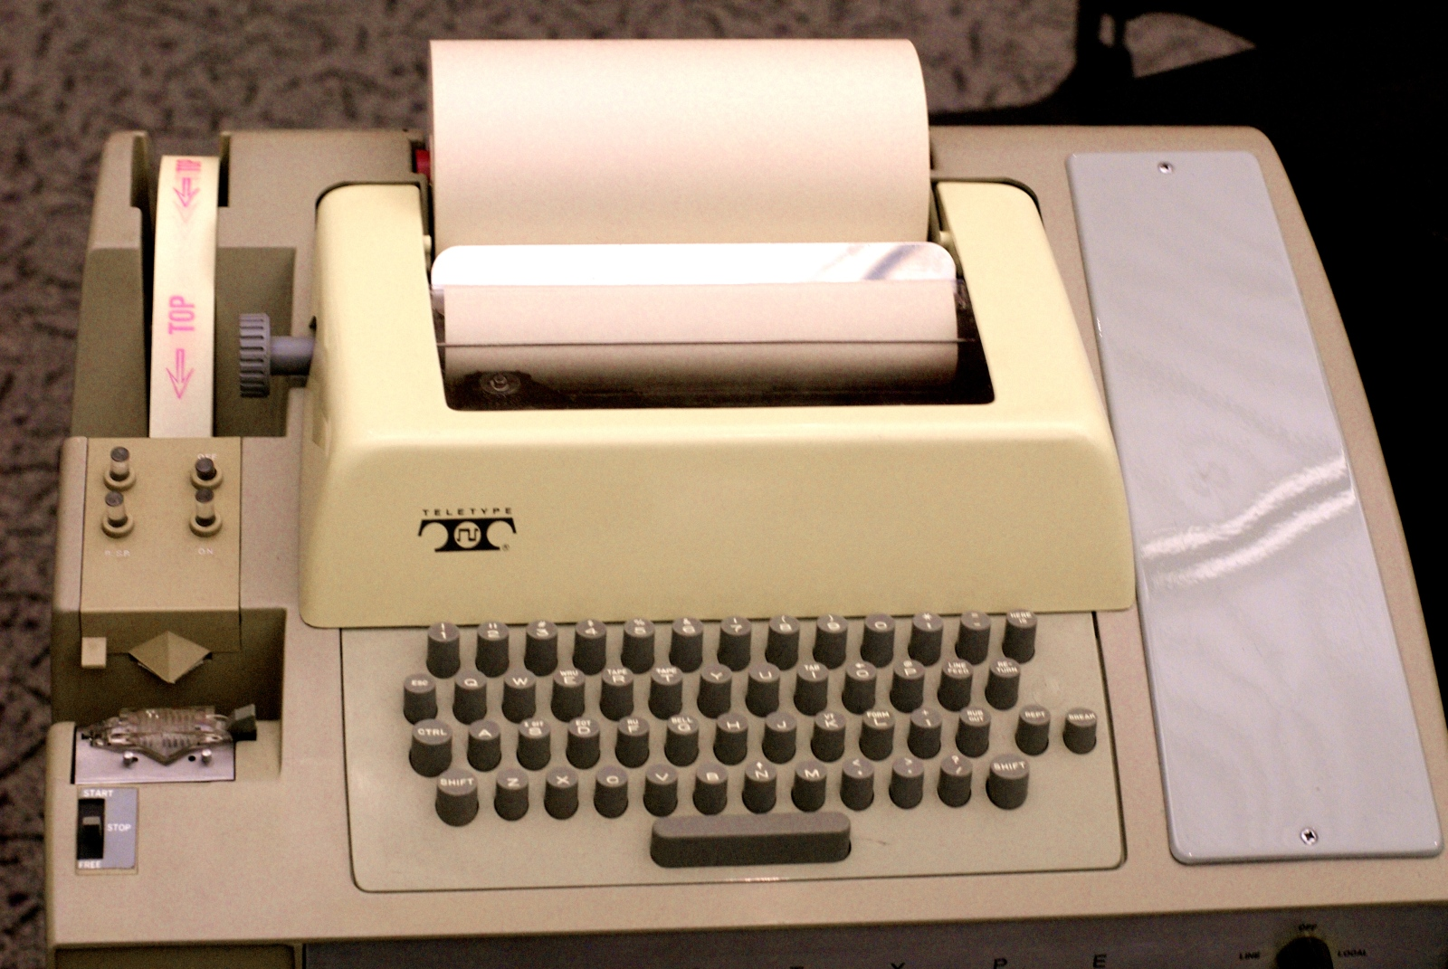
Vintage Data Terminal

Slide 13
RS-232
RS-232 is a standard for serial communication that specifies:
Connectors
Pin Assignments
Voltage Levels
Baud Rates
RS-232 uses a bipolar signal to represent logic values
+3V to +12V – represents a logical 0
-12V to -3V – represents a logical 1
Terminology
DTE – Data Terminal Equipment (Like a terminal)
DCE – Data-Circuit Terminating Equipment (Like a modem)

Slide 14
PIC32 UARTs on MX7
The PIC32 microcontroller has six UARTs
Two UARTs are accessible on the MX-7 development board
On the MX-7 board, UART1 is connected to the USB serial converter – Using this UART can cause problems when using the MPIDE development system.
UART2 signals are accessible via connector JF

Slide 15
UART SFRs

Slide 16
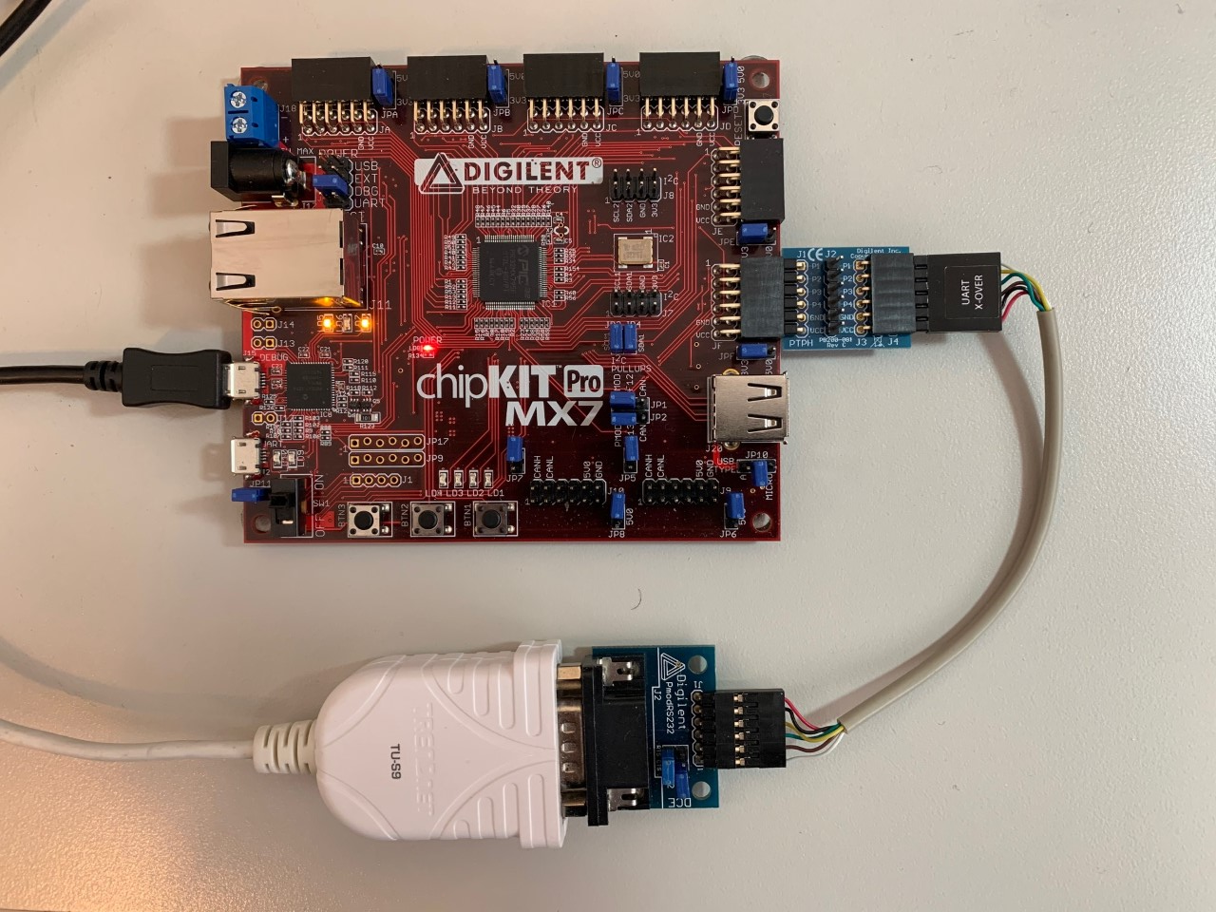
UART2 Connection on MX7

Slide 17
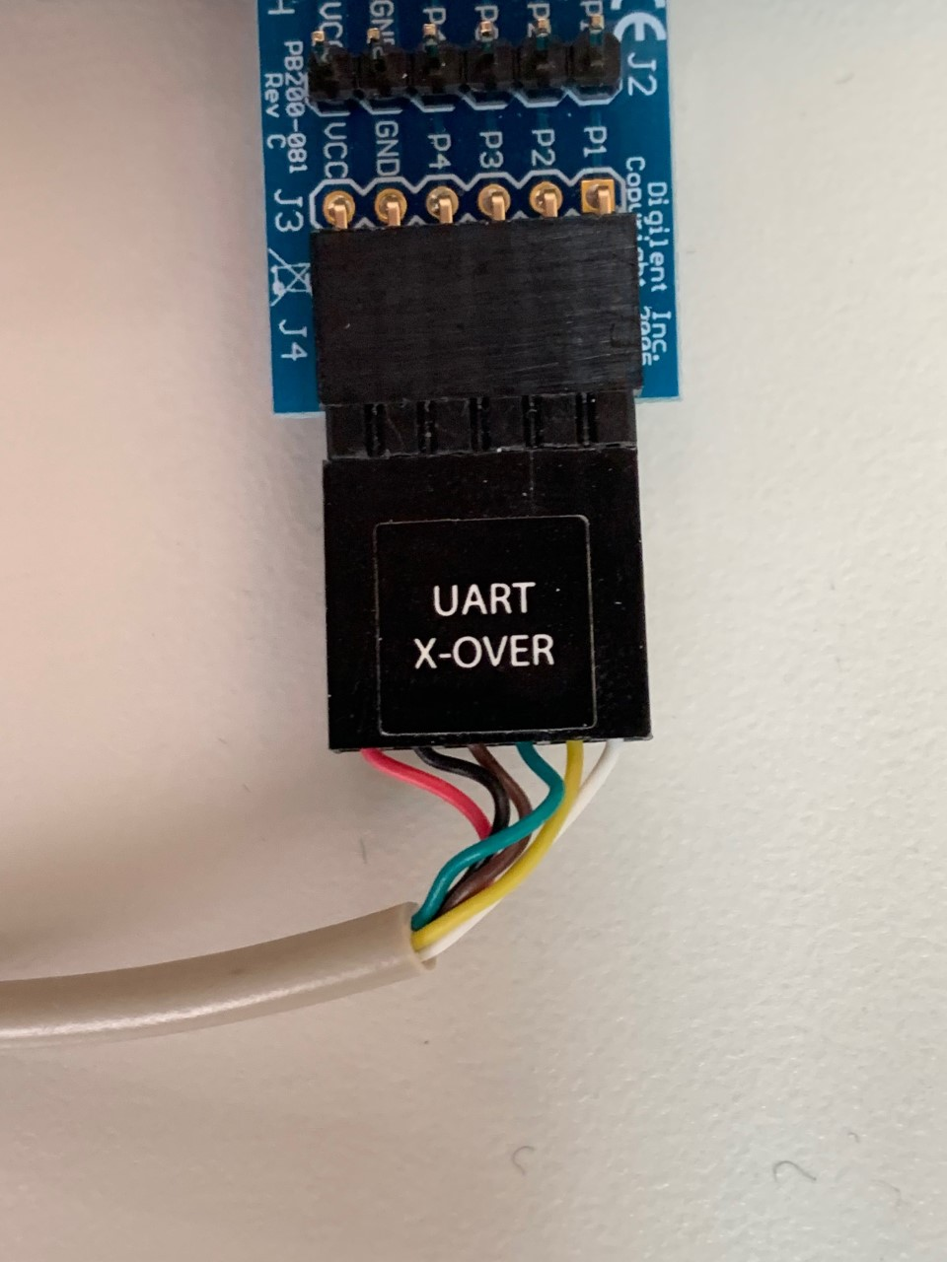
UART Crossover Cable

Slide 18
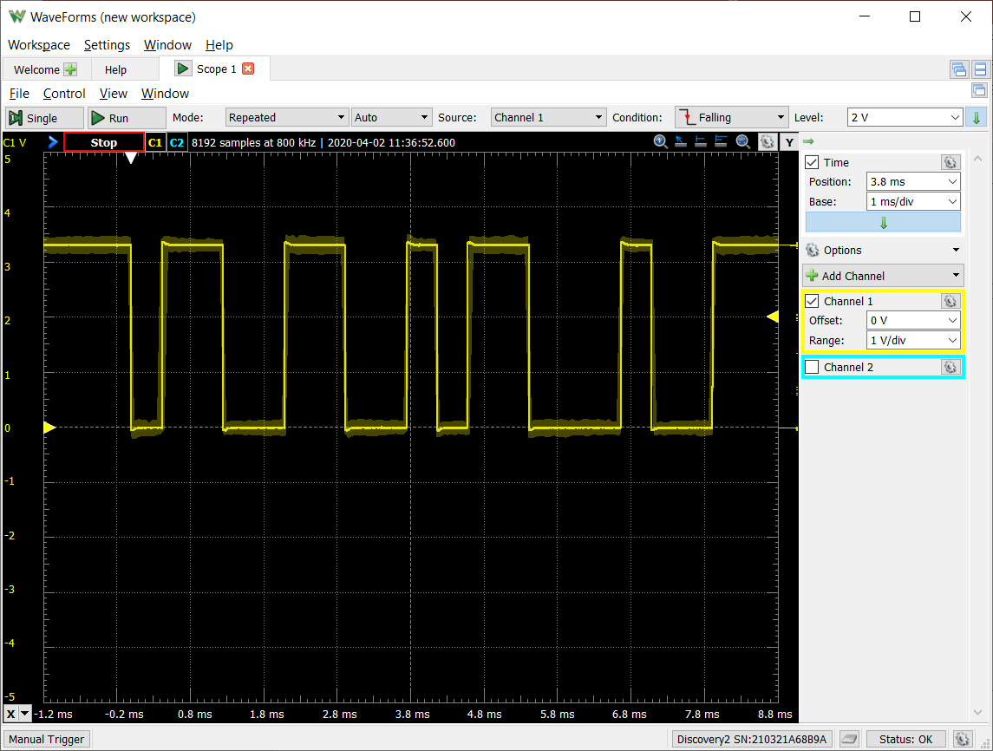
Multi-Character Transmission

